Slide 1


Financial Database Manager
Course Project for CSCI 352
by: Cody Gonsowski

Slide 2
Background
What is this project?
This project is a Financial Database Manager. It allows you to load and edit a database that allows you to save the date of the expense or income, an amount to go with the entry, and a description of what the cost or income was.
Why did I do this project?
It’s a practical application of software engineering that allows users to keep track of expenses without too much effort.
What do you need to know about this project?
Build first, then run executable. This way your database plays nice.
Refactoring the program resets the database, so be careful!

Slide 3
Approach
How did I do it?
By asking lots of questions (sorry Dr. Ericson) and Googling very many things that may have caused more problems than they helped fix.
Special libraries/drivers?
I used Extended WPF ToolkitTM by Xceed. (https://github.com/xceedsoftware/wpftoolkit)
Design patterns used:
Façade – to make adding and displaying entries easy for the user

Slide 4
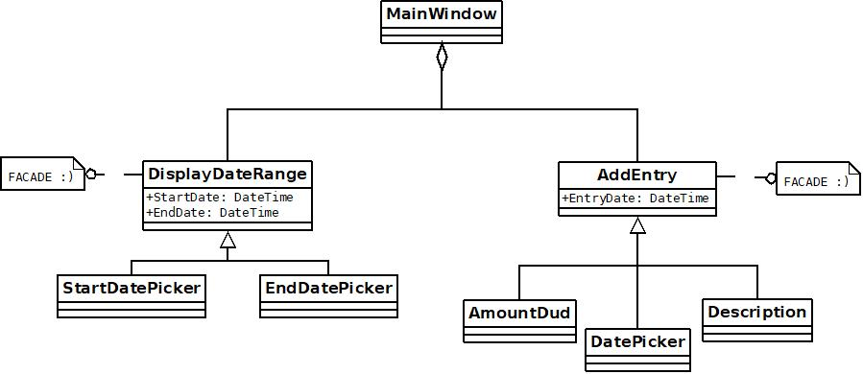
Class Diagrams

Slide 5
Demo
I already built the program once, which loads up the database for persistent use.
Just run the executable.
WARNING: Rebuilding the program resets the database, so be sure to back it up!
DEMO TIME!!!

Slide 6
Future Work
Where are you going to go next?
The original plan was to have a calendar interface that was clickable and allowed easy viewing and entering, as well as a statistical view that showed overall results for a given time period. Ideally, this would be further developed and brought to fruition for frequent use.
In addition, different user accounts would mean multiple people could use the same computer, or potentially a secure online source that lets people use it from anywhere.

Slide 7
Questions
E-mail: jondgons@ut.utm.edu
Repo: https://github.com/jondgons/Financial-Database-Manager

